Slide 1



PERSONAL PENSION PLAN
A CASE STUDY FOR A BUSINESS OWNER
A smarter way to save for your retirement®
Notes:
Thank you for coming today.

Slide 2
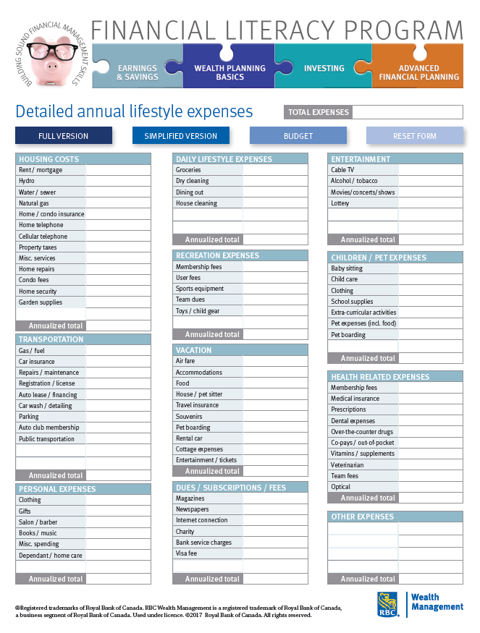




Are you ready for a PPP® upgrade?
Ask Yourself These Questions?
Do I want to pay less tax than 98% of Canadians?
Do I want to maximize my retirement income?
Do I want the tax refunds to pay for the cost of the program instead of coming out of my pocket?

Slide 3
What is a PPP® ?
A combination registered pension plan governed by section 147.1 of the Income Tax Act (Canada)
Defined Benefit Component
Current Service & Past Service
(Including Qualifying Transfer)
Locked-in (in some provinces)
Additional Voluntary Contributions
Never Locked-in
Allows transfers-in of of additional RRSP assets in order to tax deduct Investment Management Fees
0% to 17% of T4 income voluntary employee contributions
AVC
DC
DB
Defined Contribution Component
1% of T4 Income
Locked-in (in some provinces)

Slide 4
Most tax-effective registered pension plan solution allowed under the Income Tax Act (Canada)
PPP®
Money ($)
PPP®
IPP
RRSP
TFSA
Projections assume the same rate of return on assets, e.g. 5%
Time

Slide 5
A quick note about the treatment of PPPs
Monies moved out of Opco or Holdco to PPP – exempt from TOPI / TOSI
When the corporate sponsor of the PPP contributes passive assets to fund the PPP, it leaves the balance sheet of the company.
  Therefore, it is no longer “passive income” caught by the new Tax On Spit Income rules brought in by the federal government.
  This means:
    Instead of being taxed at a punitive corporate passive tax rate (especially interest income and foreign dividends), this growth occurs tax sheltered within the PPP.
    Takes longer to surpass the $50,000 safe passive income buffer where TOPI rules kick in.

Slide 6

Case Study – mid-40s Business Owner
Facts | Male, age 45, rate of return 5%
 | Corp. pays T4 of $150,000
Objectives | Incorporated in 2010
 | RRSPs to date $450,000
 | Wishes to retire at 65
 | Corp. pays tax at 12.2%

Slide 7

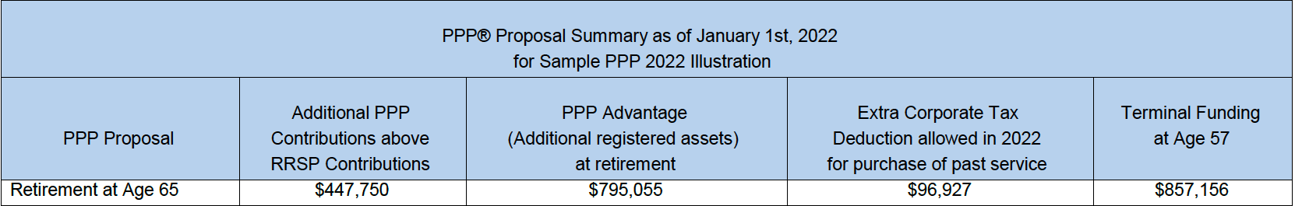
How much more can I put in a PPP® beyond an RRSP?
PART 1: Contributions

Slide 8
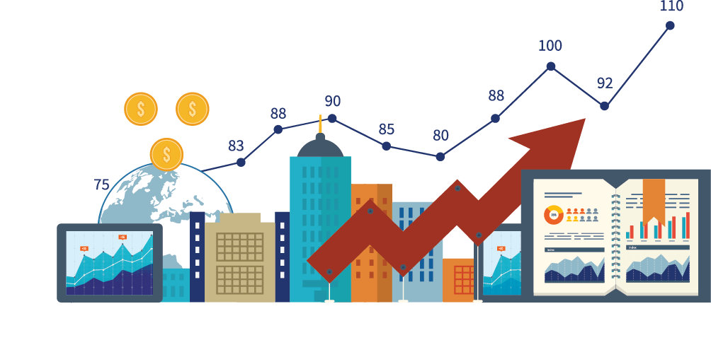
…and with 5% interest…what does that yield?
PART 1: Contributions
1
First, we get to contribute more than with an RRSP…
….then that extra capital generates returns
2

Slide 9
Impact of having contributed more than under RRSP…

Slide 10




Why so much extra contribution room?
PART 1: Contributions
Sources of the extra $447,750?
$96,927
$315,884
$30,400
$4,539
  Past Service
  Annually (cumulatively)
  Add. Personal
  Special Payments
Pension Legislation is more generous

Slide 11

Any other tax advantages unique to pensions?
PART 2: Extras

Slide 12
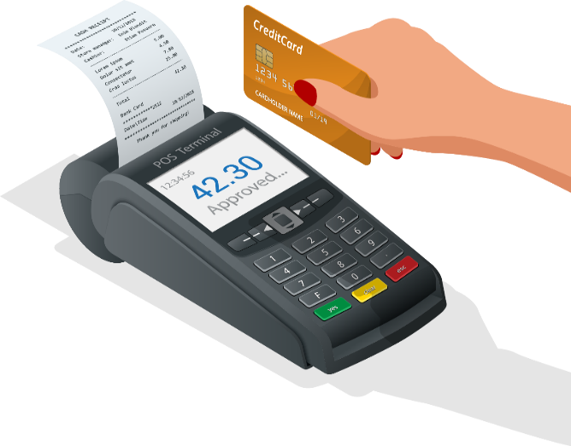
Investment Management Fees are tax-deductible
PART 2: Extras
Year | Assets Under | 1.5% Fee | 12.20%
 | Management | on AUM | Tax Refund
2022 | $ 625,544 | $ 9,383 | $ 1,145
2023 | $ 690,809 | $ 10,362 | $ 1,264
2024 | $ 760,990 | $ 11,415 | $ 1,393
2025 | $ 836,421 | $ 12,546 | $ 1,531
2026 | $ 921,268 | $ 13,819 | $ 1,686
2027 | $ 1,008,447 | $ 15,127 | $ 1,845
2028 | $ 1,101,989 | $ 16,530 | $ 2,017
2029 | $ 1,202,317 | $ 18,035 | $ 2,200
2030 | $ 1,310,466 | $ 19,657 | $ 2,398
2031 | $ 1,425,738 | $ 21,386 | $ 2,609
2032 | $ 1,549,198 | $ 23,238 | $ 2,835
2033 | $ 1,681,399 | $ 25,221 | $ 3,077
2034 | $ 1,823,209 | $ 27,348 | $ 3,336
2035 | $ 1,974,597 | $ 29,619 | $ 3,614
2036 | $ 2,136,505 | $ 32,048 | $ 3,910
2037 | $ 2,309,607 | $ 34,644 | $ 4,227
2038 | $ 2,494,616 | $ 37,419 | $ 4,565
2039 | $ 2,692,290 | $ 40,384 | $ 4,927
2040 | $ 2,903,430 | $ 43,551 | $ 5,313
2041 | $ 3,128,887 | $ 46,933 | $ 5,726
 |  |  | $ 59,617
Credit of
>
$59,617

Slide 13
Why is Fee Deductibility important?
Credit
$63,280
Minus
$ 59,617
Equal
$3,663
Actual Fees over the
entire 20-year period
Total PPP Fees over the
Entire period
Total IMF Taxes saved over the Entire period

Slide 14
What about the tax savings from being able to contribute and deduct more each year?
@12.2% =
$54,626
Credit
$3,663
Minus
$54,626
Equal
$50,963
Actual REFUND over the
entire period or
$2,548/year net of fees
Balance of Fees once fee tax refunds considered still outstanding
Credit due to taxes saved via additional contributions (assumes 12.2% corp. rate)

Slide 15
Fee conclusions
Not only does the PPP auto-finances itself in terms of fees, it actually generates extra cash in the hands of the corporation AFTER paying the INTEGRIS Fee.
And, it also generates more retirement capital (+$795,055) at the end of the 20 year period than a fully funded RRSP, assuming the exact same rate of returns (5% in this case study).

Slide 16
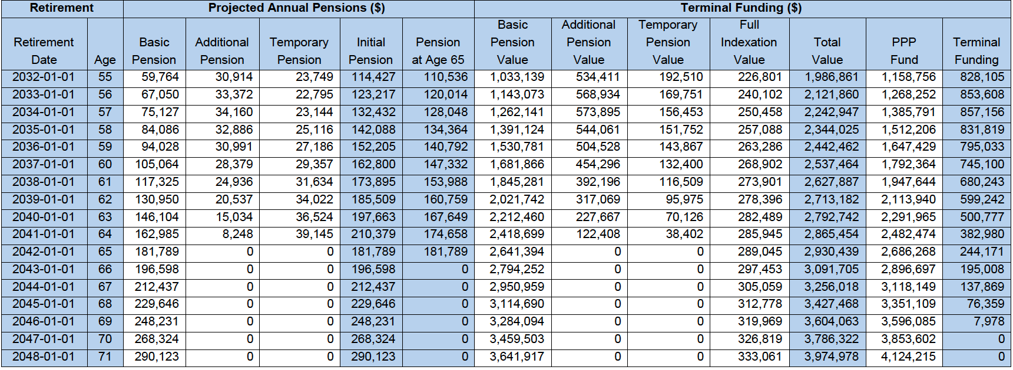
If a shift to pension income occurs – extra deductions
PART 2: Extras
Terminal Funding to start a pension sooner…
Assume Business Owner wants to turn on income at 62 instead of 65

Slide 17
If a shift to pension income occurs – extra deductions
PART 2: Extras
Basic Pension is $130,950

Slide 18
If a shift to pension income occurs – extra deductions
PART 2: Extras
If corp. contributes $ 599,242 as “terminal funding”….

Slide 19
If a shift to pension income occurs – extra deductions
PART 2: Extras
Business Owner’s income jumps to $185,509 at age 62…
An extra $54,559 annually !

Slide 20





Use Pension Income Splitting Rules as well…
PART 2: Extras
But there is more: since this annual pension is now eligible for income-splitting:
4
1
  $92,754.50 yields tax of $20,338
  X2 = $40,676
  $185,509
3
  But if split 50%-50% with spouse…
2
5
  If no income-splitting Tax in Ontario is approx. $61,620
  Owner and spouse just saved $20,944 annually in taxes !!
Not bad given that the most expensive version of the PPP has an annual cost of the PPP is $3,300…

Slide 21
PART 2: Extras
Another way to look at it:
4
1
  But $3,300 is payable to INTEGRIS
3
2
5
  PPP income splitting rules generates $20,944 per year in taxes saved
  Client has a surplus every year of $17,644!!
Perhaps a post-COVID vacation to the Caribbean every year thanks to the PPP ?

Slide 22
Summary of Results
Client is substantially wealthier in retirement than had he relied on the RRSP.
Company has saved substantially more tax than had he stayed in RRSP.
Couple saves tons of personal tax each year thanks to income splitting
The cost of the program are borne by tax refunds/savings not from the client
PLUS:
  Highest level of creditor protection in Canada
  Superior investment options (not restricted to RRSP eligible asset classes)
  Fiduciary oversight provided by team of pension lawyers at INTEGRIS

Slide 23
Are you ready for a PPP® upgrade?
PART 3: Conclusion
Ask Yourself These Questions?
Do I want to pay less tax than 98% of Canadians?
Do I want to maximize my retirement income?
Do I want the tax refunds to pay for the cost of the program instead of coming out of my pocket?

Slide 24



Maximizing Savings & Lowering Taxes using Pension Laws
1
1. Past Service
2. Current Service
3. RRSP double dip
3
4. Interest
9. HST Credit
10. $2000/yr
Pension credit
11. Income-splitting
12. Ad hoc
valuations
18. Fiduciary oversight
19. Superior investment options
20. Cross-border adv.
Your Client’s
Personal Pension Plan value chain
13. LTCGE
purification
4
5. Special
Payments
8. Terminal
Funding
17. Insurance add-on
16. Bankruptcy protection
15. Creditor
Protection
14. Inter-gen.
Wealth trsf.
2
7. PA offset amount
6. Fee Deductibility

Slide 25


Contact Us
www.thepersonalpensionplan.com
question@integris-mgt.com

Slide 26
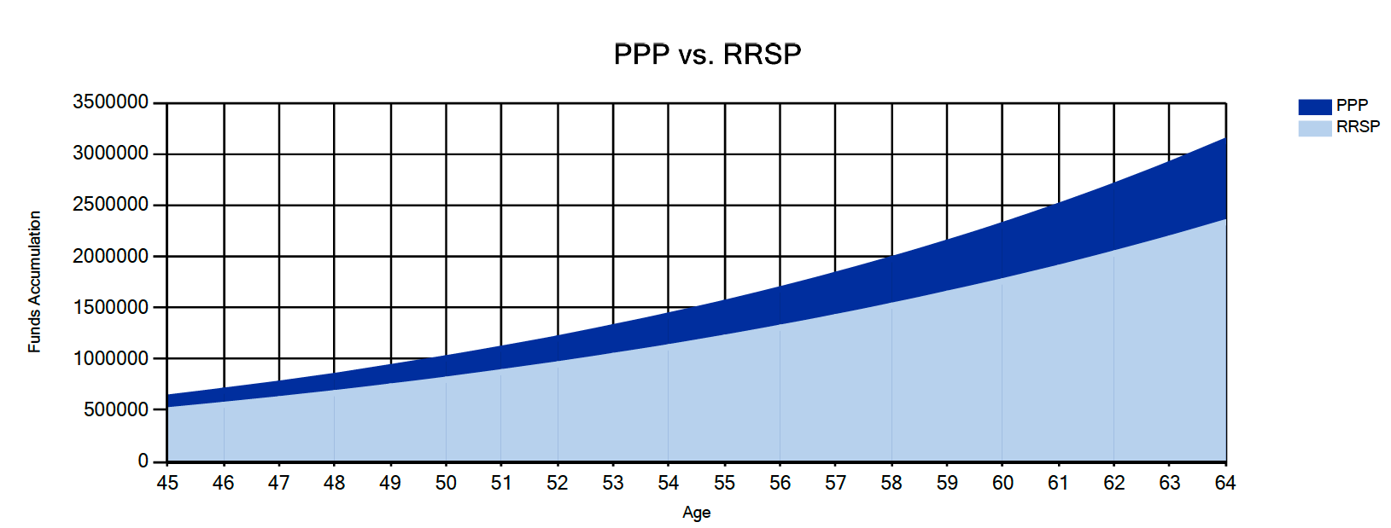
APPENDIX

Slide 27
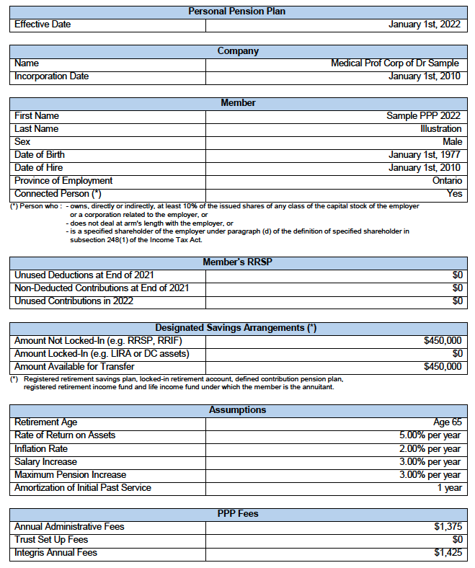
APPENDIX

Slide 28
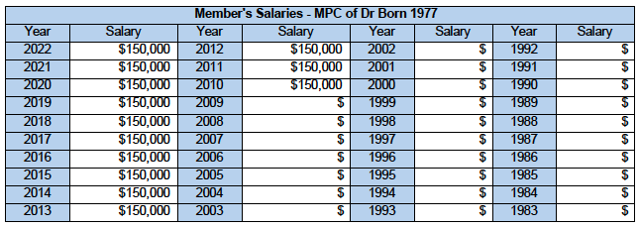
APPENDIX

Slide 29
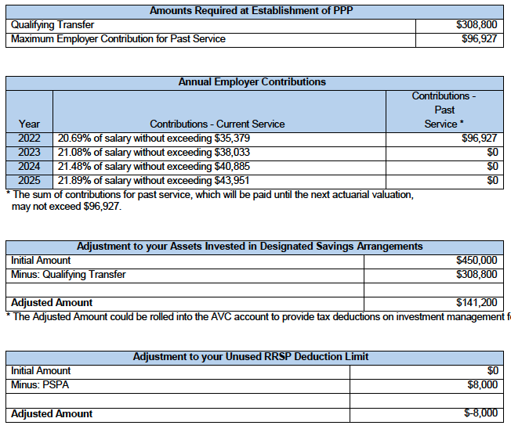
APPENDIX

Slide 30
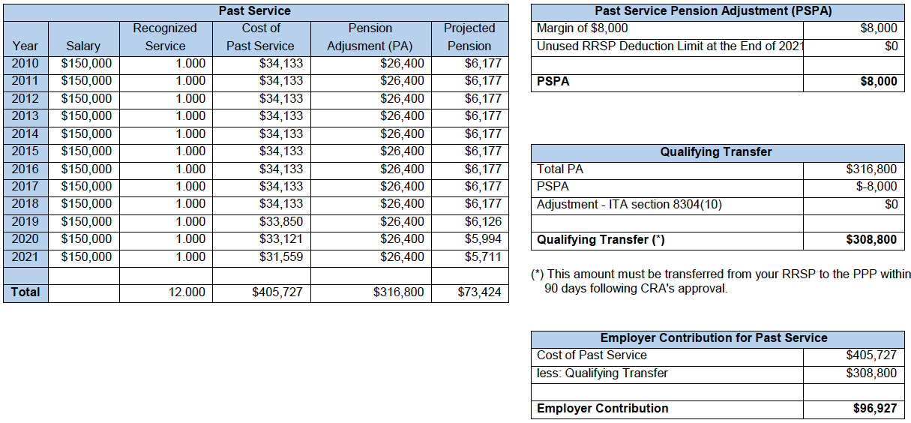
APPENDIX

Slide 31
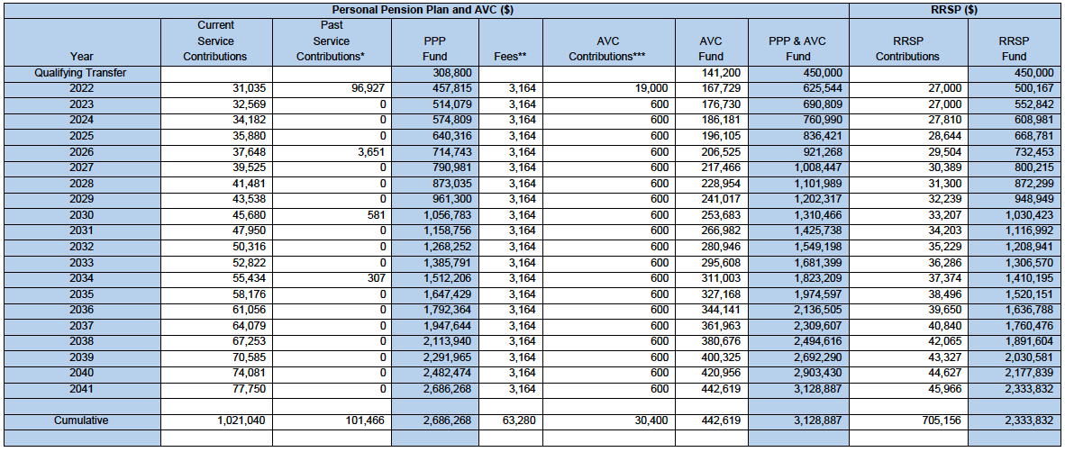
APPENDIX

Slide 32
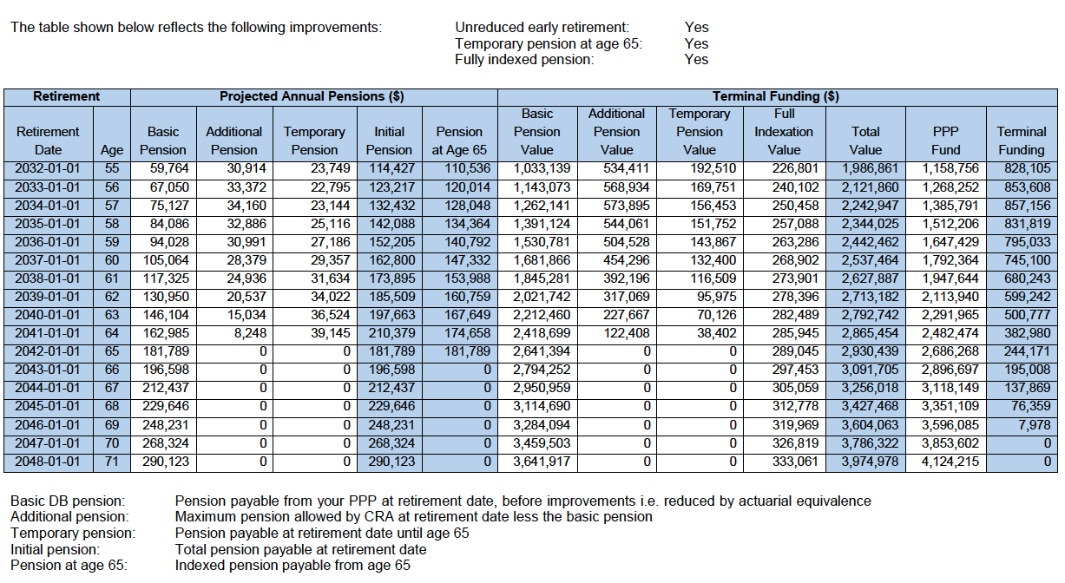
APPENDIX

Slide 33
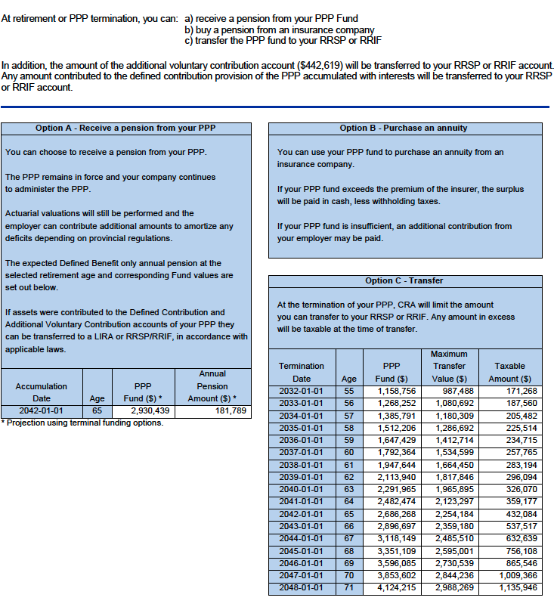
APPENDIX

